Slide 1
2021 Year in Review

Slide 2
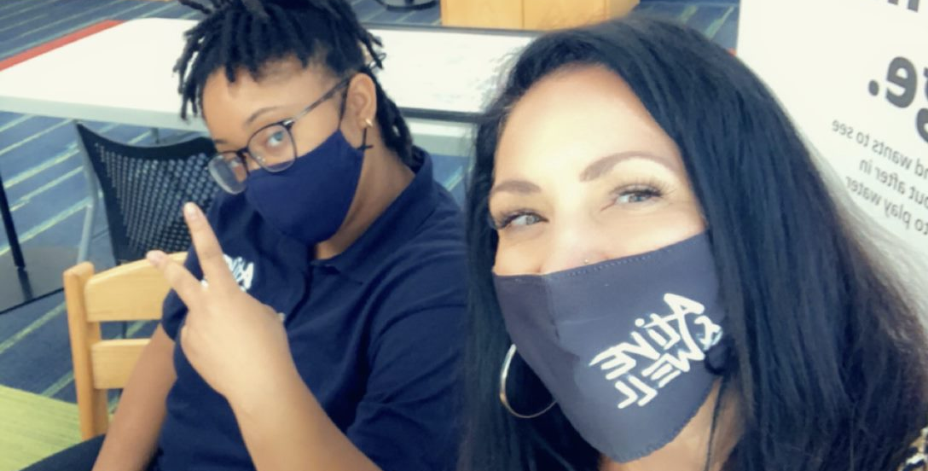
In 2021…
Alive and Well communities provided 320 trainings to more than 3000 participants.

Slide 3
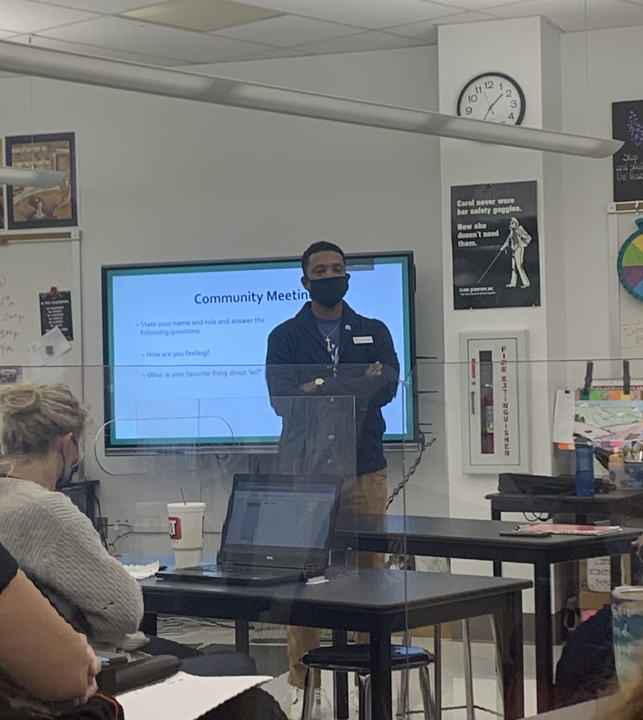
Creating Alive and Well Schools
Conducted over 265 trainings and reached over 2300 educators, administrators, counselors, social workers and support staff.
Secured new contracts with 5 major school districts (Rockwood, RGSD, U-City, KCPS, Hazelwood)
In 2021, Alive and Well was in 175 schools in 10 districts
Developed a new evaluation strategy using Results Based Accountability that connects the work we do to previously identified equity indicators.

Slide 4
Creating Alive and Well Schools (cont.)
Continued to evolve Alive and Well’s strategy to supporting schools-emphasizing customized responses to the unique challenges experienced within each school and district.
Built on the expertise of educators to provide accessible and digestible short bursts of information, narrowed down to be specifically impactful.
Further supported educational leaders and administrators in understanding and applying their role in the trauma-informed schools movement, including by tailoring existing training materials to the unique perspective of school and district leaders.
Developed, launched, and improved several activity-based learning tools, including the experiential “In Their Shoes” activity and implementing school-wide Brain Game sessions.
Scheduled to train at all district level PD in Rockwood and Hazelwood
Developed and implemented Racial and Historical Trauma trainings, pulling in district/building specific demographics and statistics.
Completed pilot project with the Missouri Developmental Disabilities Council that resulted in a toolkit for learners with intellectual disabilities https://www.awcommunities.org/learnerswithidd

Slide 5
REACH: Supporting Schools Across Missouri
Completed our contract with the Missouri Department of Elementary and Secondary Education. The #Reach4MO campaign set out to “Help Schools Heal During COVID-19”
Alive and Well developed and offered to schools critical incident debriefing, peer led supportive spaces, social emotional learning strategy teams, team trainings, and written guidance documents
1,250 participants attended sessions throughout the entire project
68 hours of trainings developed for educators by Alive and Well
REACH served educators from all DESE regions and approximately 25% of school districts in Missouri
The SELS Team developed and finalized the Self-Care Kit as a resource for schools and communities.

Slide 6
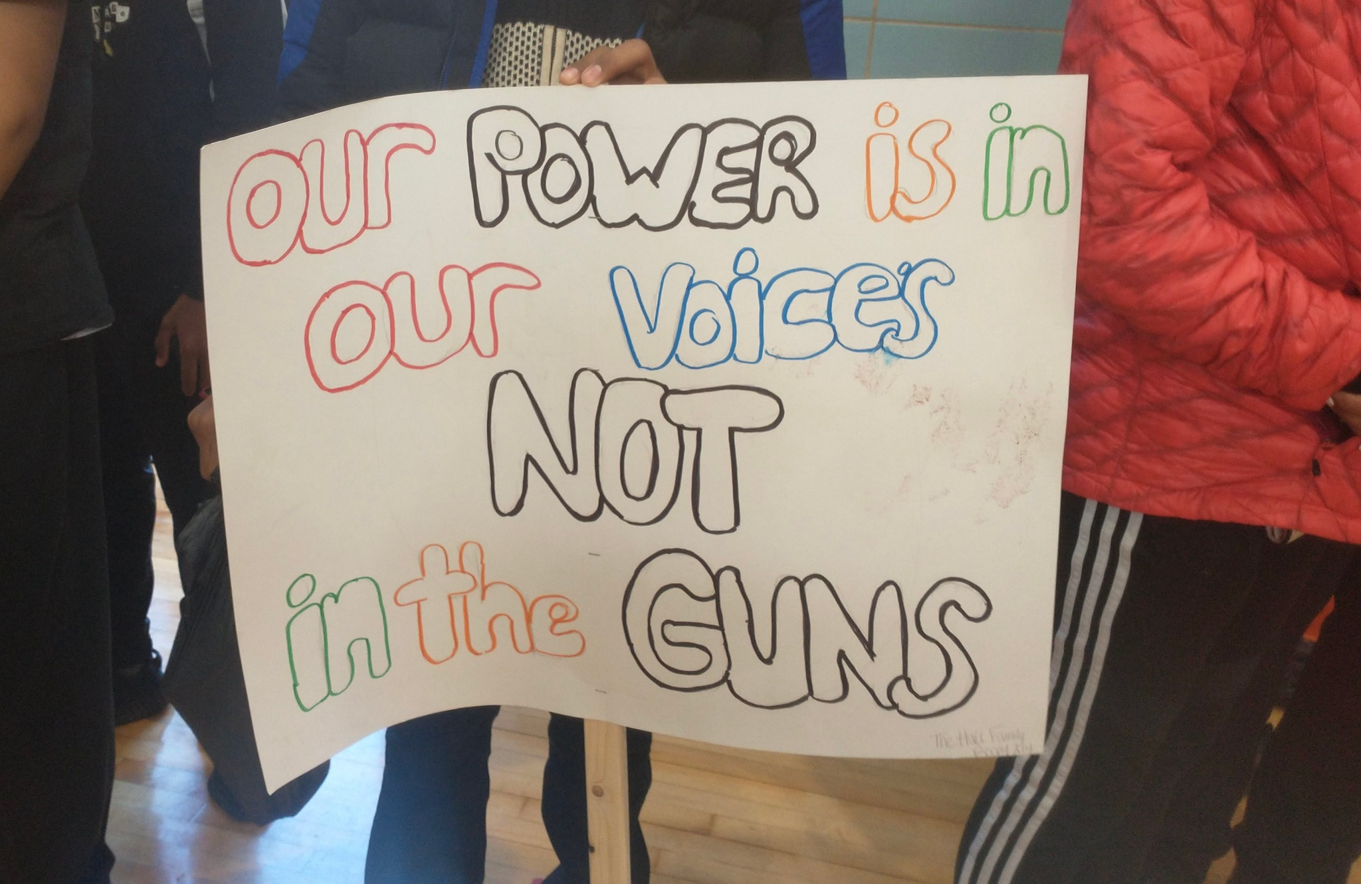
Alive and Well Youth
4 youth participated in the first youth advisory board. 40 hours spent facilitating/mentoring/coaching about School Safety and Mental Health
Youth Advisory Board participated in a panel about school safety that had 50 participants, both teens and adults, from schools and various organizations in Missouri.
The Youth Ambassador program re-started with 10 youth ambassadors started from 6 school districts in the STL region
Launched the Youth Advisory Committee, which deepens the participants’ knowledge and understanding of trauma and how it impacts the daily practice, policy creation and implementation, and the culture of schools and communities.

Slide 7
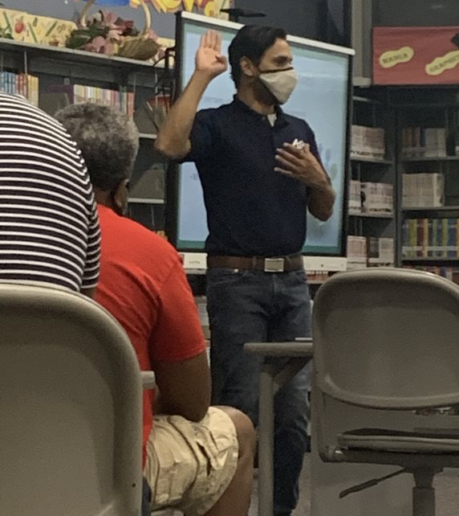
Created Trauma-Informed Healthcare Systems
Missouri Hospital Association Pilot kicked off utilizing the Missouri Model to develop equity centered trauma-informed healthcare
Launched and supported trauma-informed journeys through the Missouri Hospital Association Pilot in three major healthcare organizations, including BJC, St. Louis Children’s Hospital, and Washington University.
Over 54 hours of trainings reaching 464 individuals

Slide 8
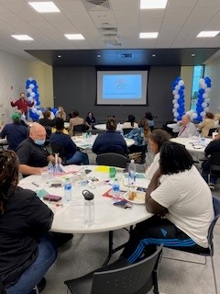
Building Alive and Well Communities
Hired 7 additional Community Consultants to expand the model in to the Bootheel
Provided 28 trainings reaching 265 individuals in the Bootheel
Consultants gave 37 Community Empowerment Workshop trainings in the STL region.
Completed 22 trainings with ARCHs on the Community Empowerment Workshops and Grief and Loss
Community Activation Leadership Cohort was developed to grow trauma-informed leaders to strategize, facilitate, and lead our community activation efforts. 14 members met over 17 hours and received training on topics like Facilitative Leadership and Policy and Legislative Advocacy
Developed a Grief and Loss training to be given to community and transferrable to schools

Slide 9
Building Alive and Well Communities
Alive and Well grew its St.Louis Steering Committee from 9 to 25.
Community streamlined trainings for Steering Committee
Joined Strategic Team of Immigrant Service Providers Network
Created and launched a newsletter called Wednesday Wellness Updates
Launched Ambassador Alert System (A3)

Slide 10
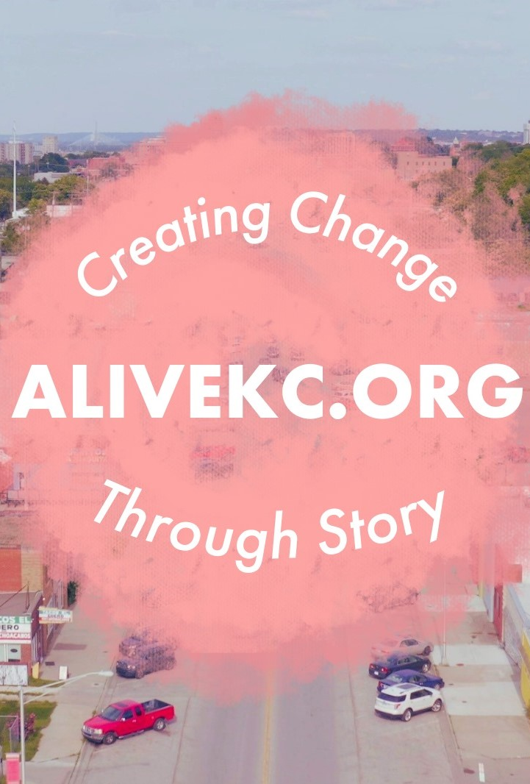
Alive and Well KC
Give Black KC 2021 raised $125,000 with 8 Black Led Organizations receiving $15,000.
Alive and Well together with the KC Ambassadors launched the #AliveKC initiative to bring awareness to racial injustices stemming from historical trauma and saw Facebook Metrics totaling 73,809 Impressions and 4,263 Post Engagements
The KC Impact Series: Empowering Black and Latinx Voices in Policy and Legislative Advocacy = 11 events with 240 participants
Ambassadors hosted 16 community events totaling 327 participants
Completed strategic planning for the integration of the Cultural Competency Collective of Greater Kansas City and Alive and Well Kansas City

